Slide 1
Mobile Data Classification
JodyAnn Bradford

Slide 2
Data Overview
Mobile Classification
Data source: https://www.kaggle.com/datasets/iabhishekofficial/mobile-price-classification
Content:
A mobile company, wants to give a tough fight to big companies like Apple,Samsung etc.
They do not know how to estimate the prices for mobile phone in their company. To solve this problem the company collects sales data of mobile phones from various companies.
They want to find out if some relationship exist between features of a mobile phone (eg:- RAM,Internal Memory etc) and its selling price.
Business problem:
A mobile start wants to estimate its mobile prices based on past sales data from other mobile companies.

Slide 3
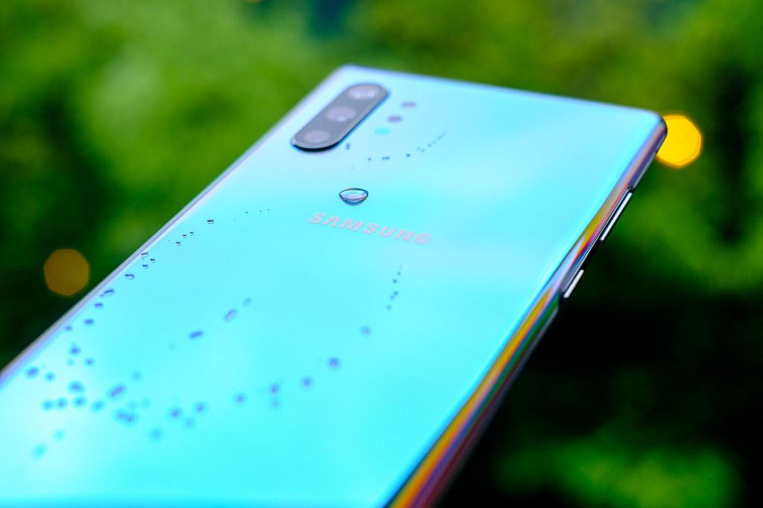
Mobile Classification
How much is your phone worth?
Speed or Price.

Slide 4
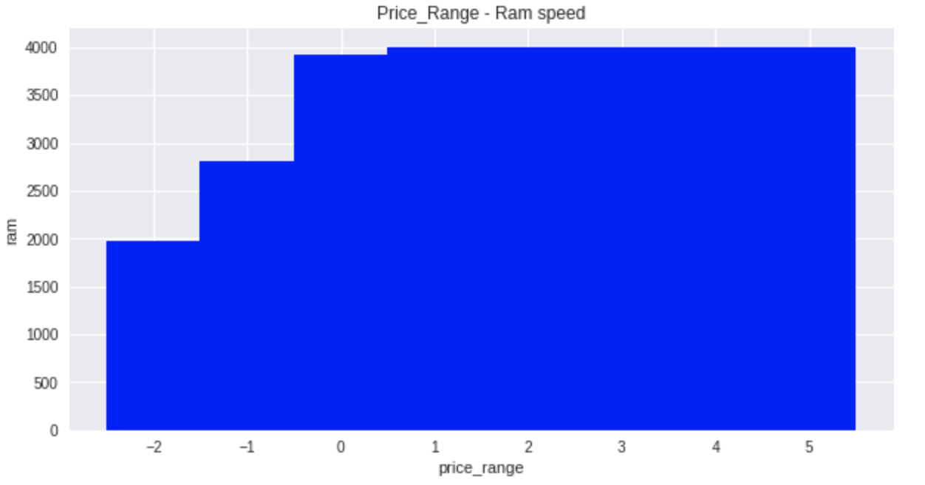
Price Range & Ram Visualization
Insight:
The graphs illustrate the price range to stay consistent from 0 to 5 with a ram speed of 4000.
Phones with a negative price range has less ram speed.

Slide 5
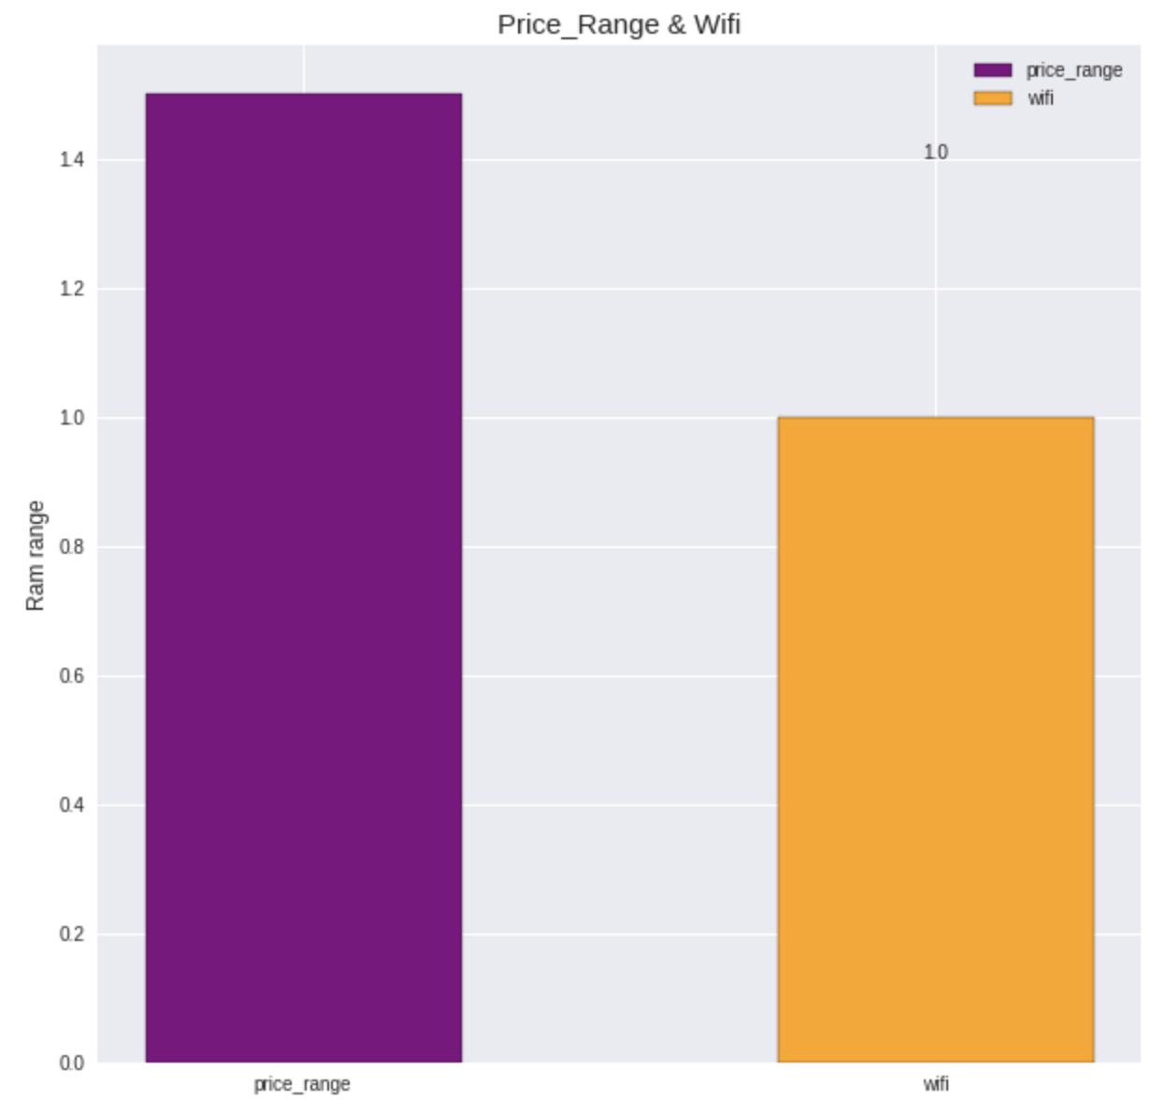
Price Range & Wifi Visualization continued.
Wifi does not add any significant value to the price range. The price range can increase while the wifi range stays the same.

Slide 6
Model Breakdown
KNN Means vs. Decision Tree Classifier
KNN Means
Best KNN Parameters: Accuracy of Best KNN model is: 0.598
With an f1 score of 1.
Decision Tree Classifier
Decision Tree Accuracy: 0.748
With an f1 score of 0.89.

Slide 7
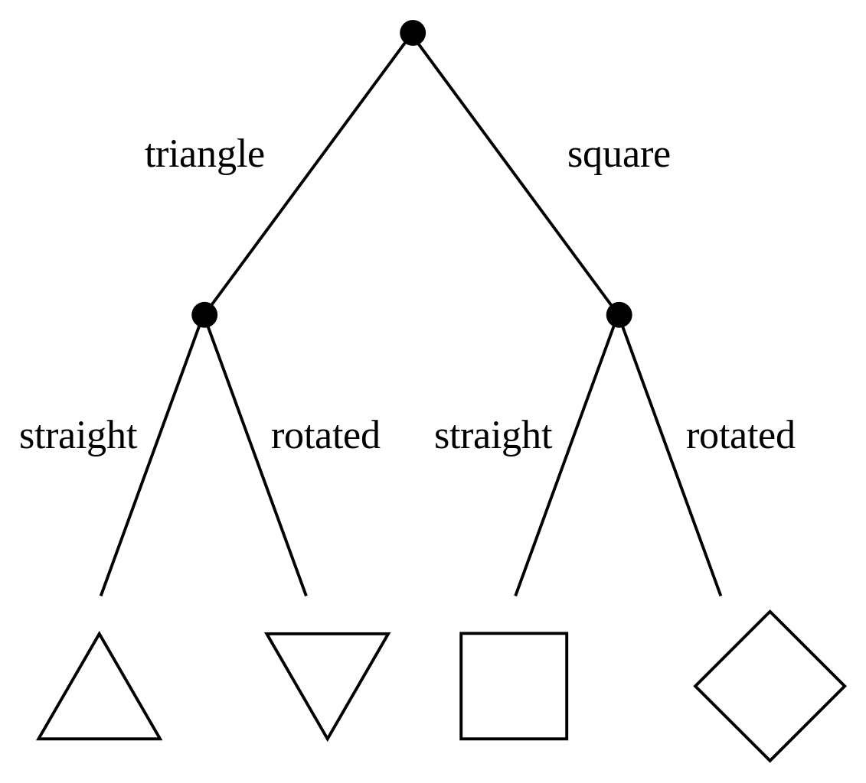
Final Model
Decision Tree Classifier
The decision tree does perform the best with an accuracy score of 0.7 but based on the limited info shared. This model would not be recommended. For instance, phone prices vary from year to year and there is no known date or year feature given to accurately determine if this model would be of any benefit.

Slide 8
Reference
Mobile Data Classification
https://whatphone.com.au/guide/why-mobile-data-is-more-expensive-than-broadband
Thank you!

